Slide 1

Human Factors & Measurement
roberto.figlie@phd.unipi.it

Slide 2
Lesson outline
Fundamentals of psychometrics
Usability scales
Mental workload
Data quality in empirical studies

Slide 3
Human Factors
Human factors (or ergonomics): understanding human capabilities and limits (cognitive, physical, social) and designing systems around them.
In HCI, human factors is about how people perceive, think, move, decide, and fail when interacting with digital systems.
Measurement is central because:
We want to know how well a system fits the human (performance, errors, workload, satisfaction).
We need numbers (read “facts and data”) to justify design decisions and claims.
Notice how they map to ISO and Nielsen definitions of usability.

Slide 4
Why Measure in HCI?
Without measurement, design/research is mostly opinion, habit, or aesthetics.
We want evidence about:
Performance: task time, error rate, throughput, learning curve.
Experience: perceived usability, mental workload, reliance, perceived control.
Safety: near-misses, critical incidents, recovery.
By measuring we are allowed to:
Compare versions, devices, or interaction techniques.
Diagnose where and why users struggle.
Build cumulative knowledge: results that generalize beyond one project.

Slide 5
From Constructs to Indicators
Most things we care about are latent constructs: “usability”, “mental workload”, “reliance”, “engagement”, “learning”.
We don’t observe them directly, we observe indicators: questionnaires, task times, error counts, clicks, eye movements, physiology.
Mapping problem:
Same construct can have multiple indicators.
Same indicator can be influenced by different constructs (long task time = bad UI, or just unfamiliarity).
Good measurement requires:
A clear definition of the construct.
A plausible link between construct and indicator.
Awareness of limitations and alternative explanations.

Slide 6
Fundamentals of Psychometrics

Slide 7
Psychometrics in a Nutshell
Psychometrics is the science of designing, evaluating, and interpreting psychological measures.
Main goals:
Create instruments that are reliable (stable, consistent).
Ensure they are valid (actually measure the intended construct).
Understand measurement error and its impact on conclusions.
In HCI we borrow and adapt scales (SUS, NASA-TLX, reliancscales, etc.).
We also sometimes build new scales for new technologies or contexts (CUS).

Slide 8
Measuring the Right Construct
Validity: are we measuring what we think we are measuring?
Main aspects:
Content validity: items adequately cover the construct’s domain (usability = effectiveness, efficiency, satisfaction).
Construct validity:
Convergent: correlates with related constructs (e.g., two usability scales).
Discriminant: doesn’t correlate too strongly with unrelated constructs (e.g., usability vs personality).
Criterion validity: predicts relevant outcomes (higher usability scores → fewer errors, faster task times).
A scale can be highly reliable but invalid (measures something else very consistently).
Popularity is not proof of validity in your specific context of use.

Slide 9
Consistency of Measurement
Reliability ≈ how much of the score is signal vs noise.
3 types:
Internal consistency: do items that are supposed to measure the same thing correlate? (Cronbach’s alpha, omega).
Test–retest reliability: if the underlying construct doesn’t change, do scores remain similar over time?
Inter-rater reliability: when human raters code behavior, do they agree?
Low reliability → more random error:
Reduces statistical power (harder to detect real effects).
Can mask real differences between interfaces.
Practical actions:
Check item–total correlations; remove or revise problematic items.
Avoid extremely vague or double-barreled items.

Slide 10
Measurement Scales & Likert Responses
Quantitative variables differ in scale type:
Nominal: categories without order (device: phone, tablet, desktop).
Ordinal: ordered but unknown interval size (Likert “strongly disagree”→“strongly agree”).
Interval: equal distances, but arbitrary zero (°C, calendar years) → you CANNOT multiply!
Ratio: equal distances, meaningful zero (duration in s, Kelvin, euros) → you CAN multiply!
Likert items:
Strictly ordinal, but often treated as approx. interval when:
We aggregate several items into sum or mean scores.
Response options are balanced and symmetric.
This is extremely important when considering which the hypothesis test to employ!

Slide 11
Usability Scales

Slide 12
Measuring Usability as a Construct
Usability (ISO 9241-11)
The degree to which a system can be used by specified users to achieve specified goals effectively, efficiently, and satisfactorily in a specified context of use.
Questionnaires are quick to administer, allow users to summarize their experience, and provide a single or few numbers to compare systems.
But perceived usability can diverge from objective performance (people can like a system that is actually slower).
Good practice:
Combine subjective usability scores with task performance.
Select scales that match your system and research question.

Slide 13
System Usability Scale (SUS)
10 items, 5-point agreement scale, technology-agnostic.
The odd-numbered questions (1, 3, 5, 7, 9) are positive statements, the even-numbered questions (2, 4, 6, 8, 10) are negative statements.
Items are summed → 0-100 score.
Strengths:
Huge body of data and meta-analyses in the literature.
Works across many domains, quick to administer.
Limitations:
Some items are awkwardly worded or dated.
Mixes usability with attitudinal acceptance and perceived satisfaction.
Use when:
You need a simple, comparable global usability score.
You want to benchmark against other systems or prior studies.

Slide 14
UMUX and UMUX-Lite
UMUX (Usability Metric for User Experience): 4 items focused on ISO usability components (usefulness, ease of use, etc.).
UMUX-Lite: 2 items (perceived usefulness + ease of use); extremely short.
Strengths:
Less burden compared to SUS.
Often correlates strongly with SUS.
Limitations:
Fewer items → more sensitive to noise or context.
Harder to diagnose why usability is low.
Use when:
Survey time is scarce (mobile, in-the-wild studies).
You need a global usability measurement but can’t afford 10 items (participants’ attention, many post task surveys)

Slide 15
Chatbot Usability Scale (BUS-11)
Dedicated scale for chatbot-specific usability / satisfaction, capturing things generic scales (SUS, UMUX) miss: conversation quality, context management, privacy, response time, not just “ease of use”.
BUS-11: 11 items, 5-point Likert
Provides also an heuristic approach for designers (BUS-CHECK)
Strengths:
Specific for chatbots.
Validated across several languages and contexts (EN, DE, NL, ES, IT), suitable for cross-country studies
Strong convergent validity with UMUX-Lite
Limitations:
Relatively young, evidence in literature is still thinner.
Mainly focused on satisfaction and perceived quality.
Use when:
You want chatbot-specific insight beyond SUS/UMUX.
You compare multiple chatbots or versions, also in different languages.

Slide 16
Mental Workload

Slide 17
Why We Care About It?
Mental workload can be roughly defined as the amount of cognitive resources required to meet task demands.
Usually, it depends on:
Task complexity and time pressure.
Interface/technology (clarity, feedback, information density).
User factors (expertise, fatigue, stress).
Theoretically the expected consequences should:
Too low → very easy tasks, higher performance, mostly automatic.
Too high → errors, slower performance, unsafe behavior, stress.
But this is not always the case, or it could be even wrong!

Slide 18
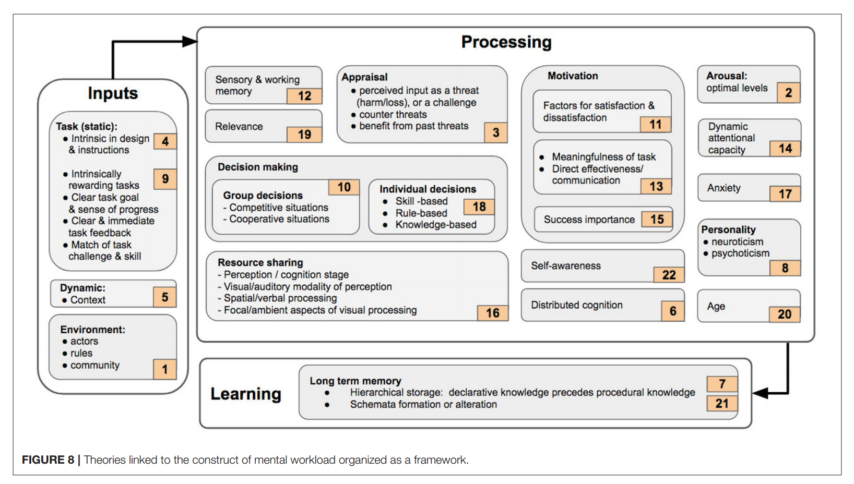
ALl that Glitters Is Not Gold pt.1
There are tens of possible definitions of Mental Workload.
Before using it, clarify if it make sense and how in your study.
And remember, Mental Workload ≠ Cognitive Load.
L. Longo, C. D. Wickens, G. Hancock, and P. A. Hancock, “Human Mental Workload: A Survey and a Novel Inclusive Definition,” Front. Psychol., vol. 13, June 2022, doi: 10.3389/fpsyg.2022.883321.

Slide 19
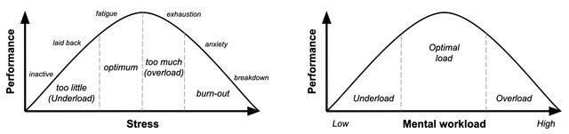
ALl that Glitters Is Not Gold pt.2
Moreover, the relationship between mental workload and performance is unclear: it could be that it follows the Yerkes-Dodson Law.
L. Longo and M. Rajendran, “A Novel Parabolic Model of Instructional Efficiency Grounded on Ideal Mental Workload and Performance,” in Human Mental Workload: Models and Applications, L. Longo and M. C. Leva, Eds., Cham: Springer International Publishing, 2021, pp. 11–36. doi: 10.1007/978-3-030-91408-0_2.

Slide 20
MWL Measurement: NASA-TLX
Six levels: mental, physical, temporal demand, performance, effort, frustration.
2 variants:
Original includes weighting between dimensions (pairwise comparisons).
Raw TLX uses unweighted average of ratings (simpler, widely used, equally valid).
Advantages:
Quick to administer (only 6 questions).
Very common in human factors, aviation, automotive, healthcare, HCI.
Limitations:
It is subjective.
Memory-based: cannot capture workload in real time.
It is not linear: the steps are not equal → you cannot say “Condition A has 30% more workload than Condition B”*
See it as a comparative tool between conditions (interfaces, tasks), not as an absolute truth about “true workload”.
* On limitations, see: E. Babaei, T. Dingler, B. Tag, and E. Velloso, “Should we use the NASA-TLX in HCI? A review of theoretical and methodological issues around Mental Workload Measurement,” International Journal of Human-Computer Studies, vol. 201, p. 103515, June 2025, doi: 10.1016/j.ijhcs.2025.103515.

Slide 21
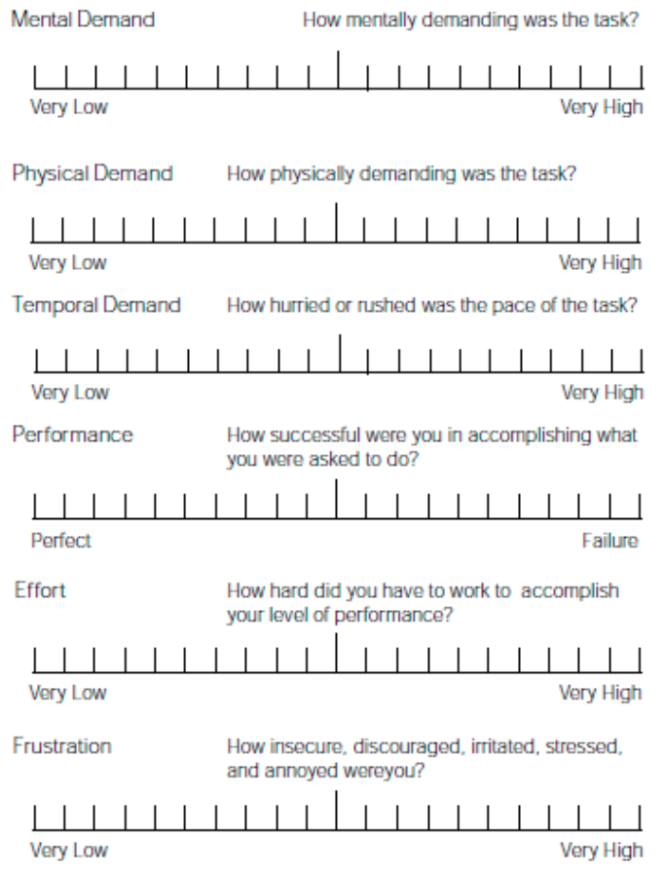
NASA-TLX

Slide 22
Other Subjective Workload Measures
SWAT (Subjective Workload Assessment Technique): asks about time pressure, mental effort, and stress, then the overall is converted to %.
RSME (Rating Scale Mental Effort): single continuous scale for mental effort.
Bedford Workload Scale: unidimensional 10-point rating scale, structured as a hierarchical decision tree.
MRQ (Multiple Resources Questionnaire): 17-item questionnaire based on Multiple Resource Theory (visual vs auditory, spatial vs verbal, etc.)
Trade-offs:
Short scales (1–3 items)
+ Very fast, low burden.
– Less detailed, mainly good for simple comparisons (“A > B”).
Longer / multi-dimensional scales
+ More diagnostic: show why workload is high (time pressure? info overload? stress?).
– Take longer to fill in, can cause fatigue if repeated often.

Slide 23
Physiological Indicators of Workload
Heart rate (HR) and heart rate variability (HRV) → arousal, stress, effort.
Pupil dilation → cognitive load, but sensitive to lighting.
Skin conductance (EDA/GSR) → sympathetic arousal.
Eye tracking → fixation patterns, blink rate, gaze transitions.
EEG / fNIRS* → brain-level signals.
Pros:
Continuous over time: can capture dynamic changes within a task.
Less prone to self-report biases.
Cons:
Intrusive or uncomfortable sensors, sensitive to artifacts (movement, environment).
Interpretation is indirect: many signals correlate with general arousal, not only workload.
Often require a lab.
Good practice:
Probably it is a good idea to use physiology to complement behavioral and subjective data, not to replace them.
* EEG: electroencephalogram, fNIRS: functional near-infrared spectroscopy

Slide 24
Data Quality

Slide 25
Data Quality as a Research Problem
Poor data quality = poor measurement of humans
Main threats:
Inattentive or random responding (speeding, straight-lining).
Misunderstood tasks or questions (ambiguous wording, poor examples).
Demand characteristics: participants respond according to what they think you want. Really insidious!
Technical issues: logging errors, missing data, timeouts.
In online HCI studies, participants multi-task, use small screens, get distracted, or run ad-blockers that break logging.
Result:
Biased or noisy data → false negatives (missing real effects) or false positives (seeing effects that aren’t robust).

Slide 26
Designing for Better Data Quality
Study design:
Clear, concise instructions with examples and maybe a practice block.
Limit total session duration.
Align compensation with effort.
Instruments:
Pilot test questionnaires and tasks with a small sample.
Avoid jargon and multi-barreled questions (asking more than a topic at once).
Checks and filters:
Attention checks (used carefully and transparently).
Comprehension checks to test whether a participant has understood critical information.
Look out for bots, cheaters and slackers:
Monitor task completion times: too fast or too slow observations may be suspect.
Look for patterns: straight-lining, impossible answer combinations.

